Slide 1
CSDA 5430 Predictive Analytics
Chapter 12
k-Means Clustering
Notes:
https://www.socr.umich.edu/people/dinov/courses/DSPA_notes/12_kMeans_Clustering.html

Slide 2
Introduction
Clustering as an unsupervised machine learning task
The silhouette plots for assessing the reliability of clustering
The k-Means clustering algorithm
Case studies
Hierarchical clustering

Slide 3
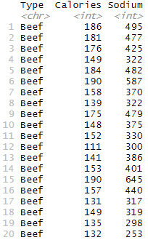
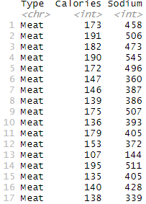
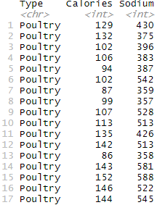
Clustering as a Machine Learning Task
Clustering unlabeled cases into groups

Slide 4
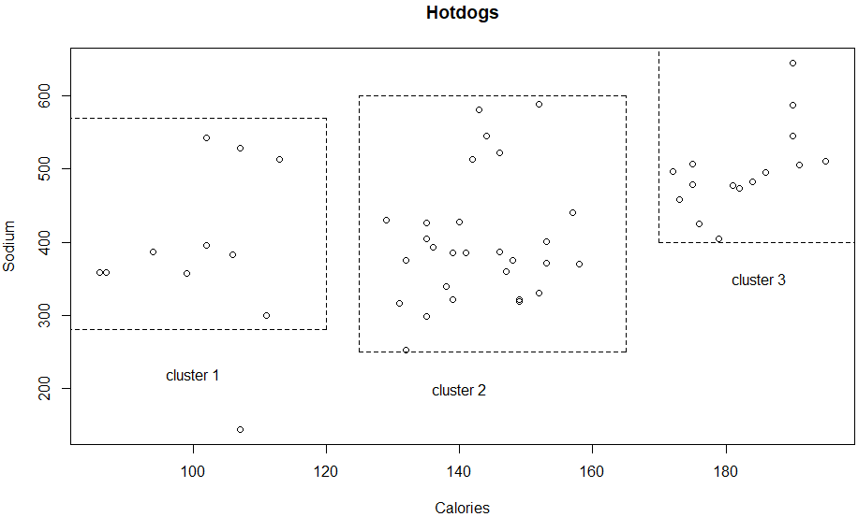
Clustering as a Machine Learning Task
Clustering unlabeled cases into groups
Assuming we don’t know much about the ingredients
In terms of calories and sodium, these hot dogs are separated into three clusters
Clusters
1: low calories and medium sodium content
2: both calorie and sodium at medium levels
3: both calories and sodium at high levels

Slide 5
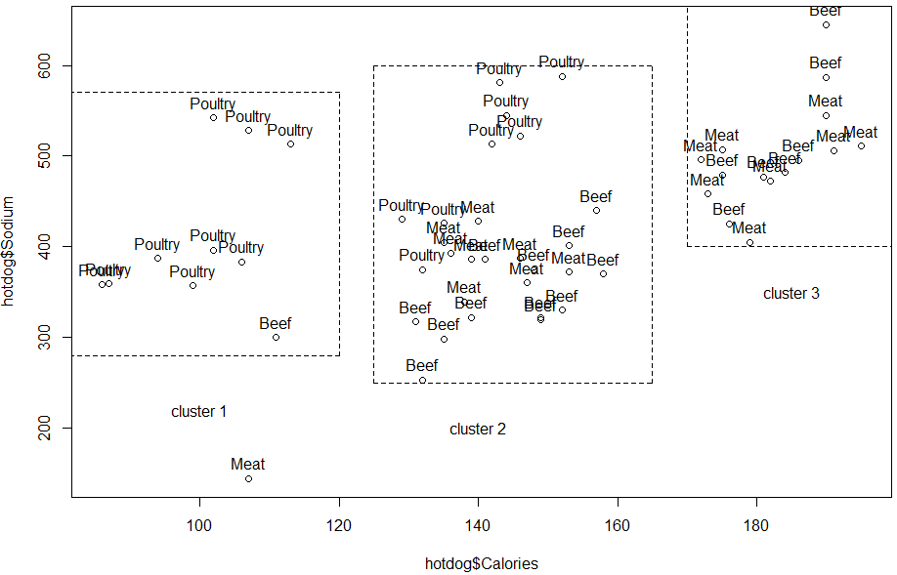
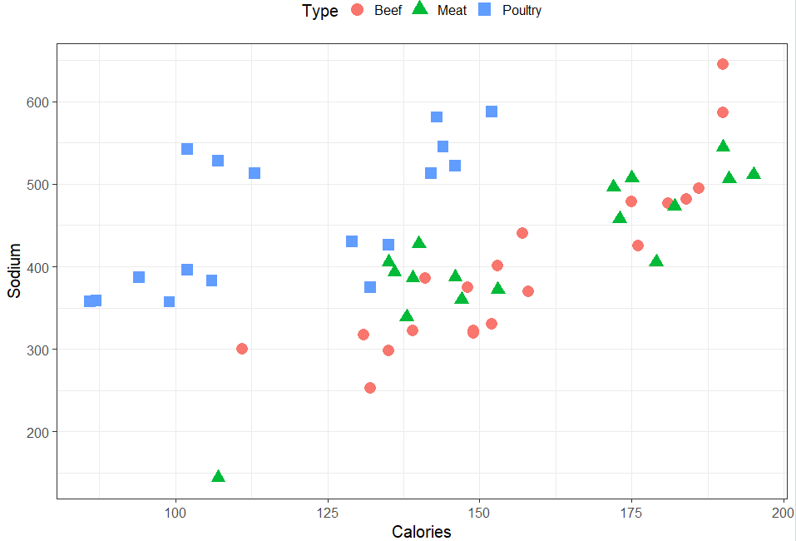
Clustering as a Machine Learning Task
Clustering unlabeled cases into groups

Slide 6
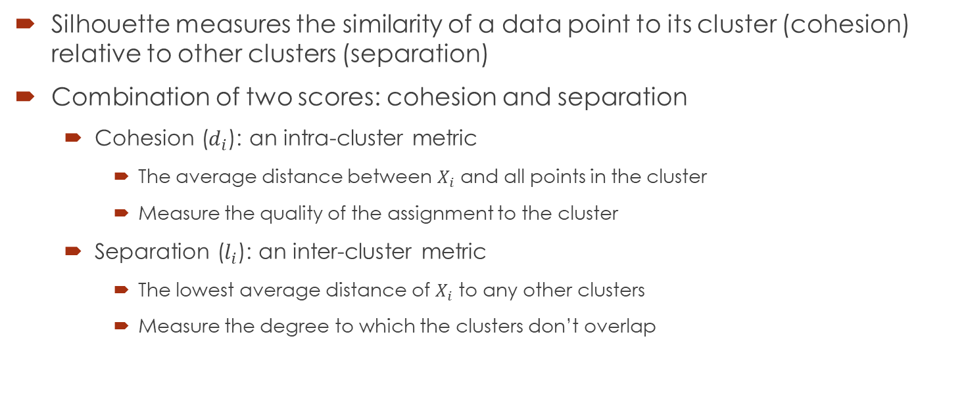
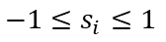
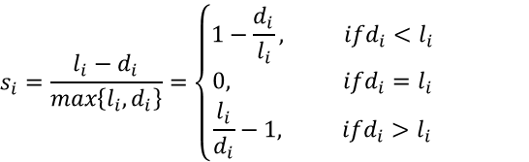
Silhouette Plots
Silhouette measures the similarity of a data point to its cluster (cohesion) relative to other clusters (separation)
Combination of two scores: cohesion and separation
Cohesion ($d_{i}$): an intra-cluster metric
The average distance between $X_{i}$ and all points in the cluster
Measure the quality of the assignment to the cluster
Separation ($l_{i}$): an inter-cluster metric
The lowest average distance of $X_{i}$ to any other clusters
Measure the degree to which the clusters don’t overlap
$$s_{i}=\frac{l_{i}−d_{i}}{max\left\{l_{i},d_{i}\right\}}=\left\{\begin{aligned}1−\frac{d_{i}}{l_{i}}, ifd_{i}<l_{i} \\ 0, ifd_{i}=l_{i} \\ \frac{l_{i}}{d_{i}}−1, ifd_{i}>l_{i}\end{aligned}\right.$$
$$−1≤s_{i}≤1$$

Slide 7
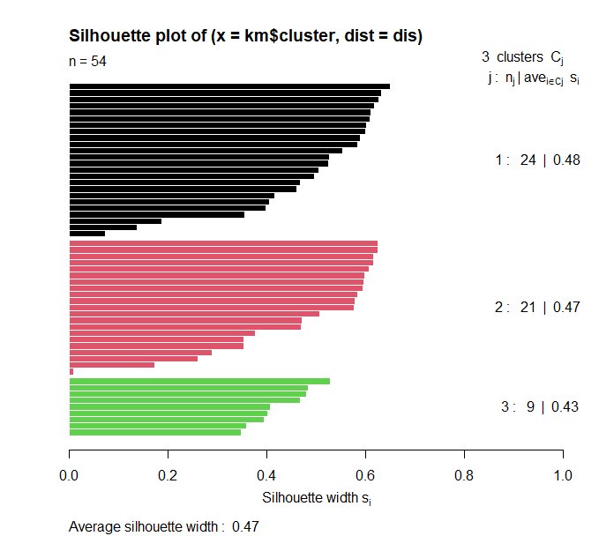
Silhouette Plots
Interpretation and validation of consistency of clustering algorithms
High value (s_{i} → 1)
Implies the data is appropriately clustered
Low value (s_{i} → -1)
Implies a poor match
s_{i} ∼ 0
Means on the border between two clusters
Example, clustering hotdogs
54 observations, 3 clusters

Slide 8
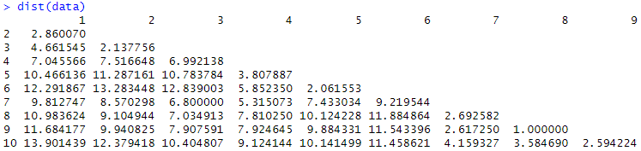
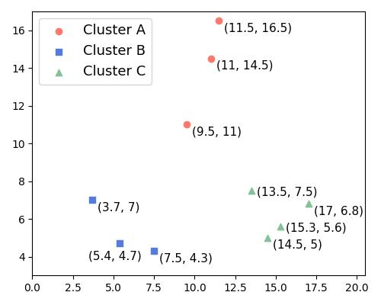
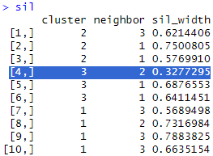
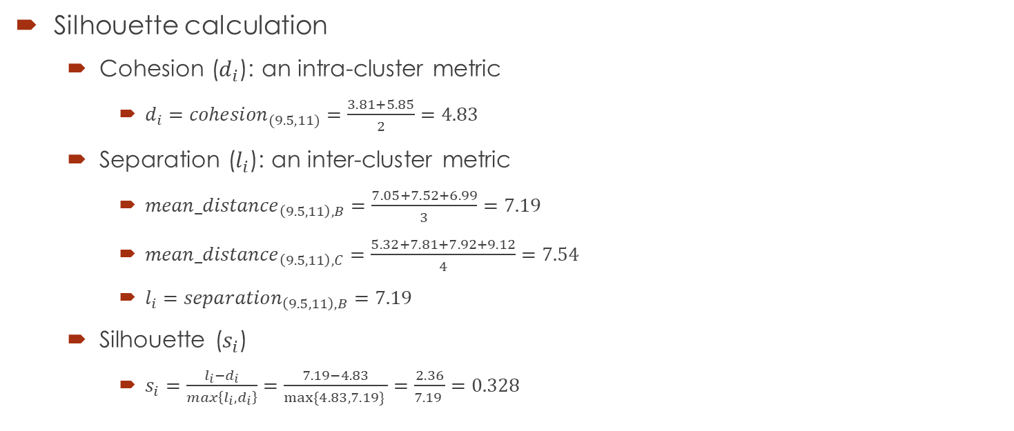
Silhouette Plots
Silhouette calculation
Cohesion ($d_{i}$): an intra-cluster metric
$d_{i}={cohesion}_{(9.5,11)}=\frac{3.81+5.85}{2}=4.83$
Separation ($l_{i}$): an inter-cluster metric
${mean_distance}_{\left(9.5,11\right),B}=\frac{7.05+7.52+6.99}{3}=7.19$
${mean_distance}_{\left(9.5,11\right),C}=\frac{5.32+7.81+7.92+9.12}{4}=7.54$
$l_{i}={separation}_{\left(9.5,11\right),B}=7.19$
Silhouette ($s_{i}$)
$s_{i}=\frac{l_{i}−d_{i}}{max\left\{l_{i},d_{i}\right\}}=\frac{7.19−4.83}{max⁡\{4.83,7.19\} }=\frac{2.36}{7.19 }=0.328$
Notes:
# https://www.baeldung.com/cs/silhouette-values-clustering
x <- c(3.7, 5.4, 7.5, 9.5, 11, 11.5, 13.5, 14.5, 15.3, 17.6)
y <- c(7, 4.7, 4.3, 11, 14.5, 16.5, 7.5, 5, 5.6, 6.8)
data <- as.data.frame(cbind(x,y))
plot(data)
text(data, labels = c(1,2,3,4,5,6,7,8,9,10), pos=4)
dist(data)
euclidean <- function(a, b){
sqrt(sum((a-b)^2))
}
euclidean(data[4,], data[5,])
#sqrt((9.5-11)^2+(11-14.5)^2)=3.81
euclidean(data[4,], data[6,])
#sqrt((9.5-11.5)^2+(11-16.5)^2)=5.85
euclidean(data[8,], data[9,])
#sqrt((14.5-15.3)^2+(5-5.6)^2)=1.00
euclidean(data[1,], data[10,])
#sqrt((3.7-17.6)^2+(7-6.8)^2)=13.90
data_clusters<-kmeans(data, 3)
data_clusters$cluster
dis = dist(data)
library(cluster)
sil = silhouette(data_clusters$cluster, dis)
summary(sil)
plot(sil, col=c(1:length(data_clusters$size)))
library(ggplot2)
factoextra::fviz_silhouette(sil, label=T, palette = "jco", ggtheme = theme_classic())
# z-score rescaling
data_z<- as.data.frame(lapply(data, scale))
str(data_z)
plot(data_z)
text(data_z, labels = c(1,2,3,4,5,6,7,8,9,10), pos=4)
data_z_clusters<-kmeans(data_z, 3)
data_z_clusters$cluster
data_z_dis = dist(data_z)
library(cluster)
sil_z = silhouette(data_z_clusters$cluster, data_z_dis)
summary(sil_z)
plot(sil_z, col=c(1:length(data_z_clusters$size)))
factoextra::fviz_silhouette(sil_z, label=T, palette = "jco", ggtheme = theme_classic())

Slide 9
The k-Means Clustering Algorithm
Divide the sample into a predetermined number k of non-overlapping clusters
Clusters are as homogeneous as possible
Pre-specify a desired number of clusters, k
Assign each case to one of the k clusters to minimize dispersion within the clusters
Measure of within-cluster dispersion
Sum of squared Euclidean distances from centroid

Slide 10
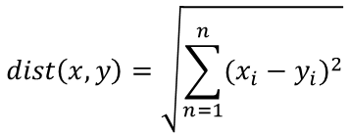
The k-Means Clustering Algorithm
Using distance to assign and update clusters
Initiation
Define k points as cluster centers
Assignment
Determine the maximum extent of the cluster boundaries by computing the distances between each point and the current cluster centers
Update
Update the centers of our clusters to the new means of all points in the cluster vicinity
Iterate assignment and update
Stop when moving any more records between clusters increases cluster dispersion
$$dist\left(x,y\right)=\sqrt{\sum_{n=1}^{n}{{(x_{i}−y_{i})}^{2}}}$$

Slide 11
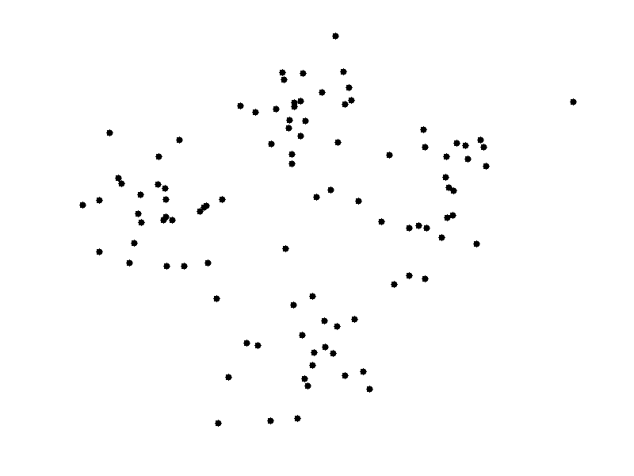
The k-Means Clustering Algorithm
Using distance to assign and update clusters

Slide 12
The k-Means Clustering Algorithm
Using distance to assign and update clusters

Slide 13
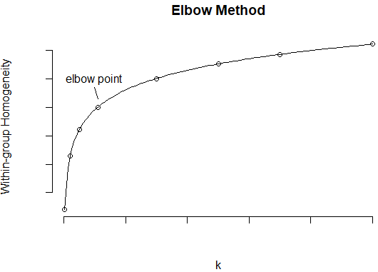
Choosing the Appropriate Number of Clusters – k
Number of clusters (k) should not be too big or too small
Need knowledge and practical considerations
The elbow method may be used
Relationship of k and homogeneity of clusters
Notes:
# Estimate Elbow point
estimateElbowPoint <- function(xValues, yValues) {
# Determine the extreme values to create line
max_x_x <- max(xValues)
max_x_y <- yValues[which.max(xValues)]
max_y_y <- min(yValues)
max_y_x <- xValues[which.min(yValues)]
max_df <- data.frame(x = c(max_y_x, max_x_x), y = c(max_y_y, max_x_y))
# Create a straight line between the extreme values
fit <- lm(max_df$y ~ max_df$x)
# compute Euclidean Distance from point to line
distances <- c()
for(i in 1:length(xValues)) {
distances <- c(distances,
abs(coef(fit)[2]*xValues[i] - yValues[i] + coef(fit)[1]) / sqrt(coef(fit)[2]^2 + 1^2))
}
# Determine the Max distance point
x_max_dist <- xValues[which.max(distances)]
y_max_dist <- yValues[which.max(distances)]
return(c(x_max_dist, y_max_dist, max(distances)))
}
# Define elbow-drawing function
# https://en.wikibooks.org/wiki/Linear_Algebra/Orthogonal_Projection_Onto_a_Line
# https://en.wikipedia.org/wiki/Vector_projection
drawElbowGraph <- function(x_K_clusters, y_WGH_values) {
nbValues = length(y_WGH_values)
extremes_lineSlope = (y_WGH_values[nbValues] - y_WGH_values[1]) / (x_K_clusters[nbValues] - x_K_clusters[1])
extremes_orth_lineSlope = -1 / extremes_lineSlope
elbowPoint_orth_proj = c(elbowPoint[1] + elbowPoint[3]/2,
elbowPoint[2] + extremes_orth_lineSlope * (elbowPoint[3]/2))
e1 = c(x_K_clusters[nbValues]-x_K_clusters[1], y_WGH_values[nbValues]-y_WGH_values[1]) # bottom-left (origin) point
e2 = c(elbowPoint[1]-x_K_clusters[1], elbowPoint[2]-y_WGH_values[1]) # elbow point, e2
p = ((e1 %*% e2)[1,1]/(e1 %*% e1)[1,1]) * e1 + c(x_K_clusters[1], y_WGH_values[1]); p # Projection point
distP <- e2-p
dist <- sqrt((distP %*% distP)[1,1])
distLabel <- (e2+p)/2 + c(100, 2)
# plot(x_K_clusters, y_WGH_values, type="b", main='Within-Group Homogeneity (WGH) vs. number of clusters (k)',
# xlab = 'k', ylab = 'WGH Value')
# lines(x=c(x_K_clusters[1], x_K_clusters[nbValues]), y=c(y_WGH_values[1], y_WGH_values[nbValues]),
# type="b", col='green')
# lines(x=c(elbowPoint[1], p[1]), y=c(elbowPoint[2], p[2]), type="b", col='red')
plot_ly(x = ~x_K_clusters, y = ~y_WGH_values, type="scatter", mode = "markers+lines", name="Data") %>%
add_lines(x = c(x_K_clusters[1], x_K_clusters[nbValues]), name="reference",
y = c(y_WGH_values[1], y_WGH_values[nbValues]), type = 'scatter', mode = 'lines') %>%
add_lines(x = c(elbowPoint[1], p[1]), y = c(elbowPoint[2], p[2]), type = 'scatter',
name="Max Distance (Elbow)", mode = 'lines') %>%
layout(title='Within-Group Homegeneity (WGH) vs. number of clusters (k)',
xaxis = list(title="k"), # scaleanchor="y"),
yaxis = list(title="WGH Value"), #, scaleanchor="x"))
legend = list(orientation = 'h'),
annotations = list(text=paste0("MaxDist=", round(dist, 3)),
x=distLabel[1], y=distLabel[2], textangle=0, showarrow=T,
xref = "x", yref = "y", ax = 80, ay = -40))
}
# Test the function: drawElbowGraph()
x <- c(30, 200, 500, 1096.663, 3000, 5000, 7000, 10000)
y <- function(x){
return (log(x))
}
elbowPoint = estimateElbowPoint(xValues = x, yValues = y(x))
drawElbowGraph(x_K_clusters=x, y_WGH_values=y(x))

Slide 14
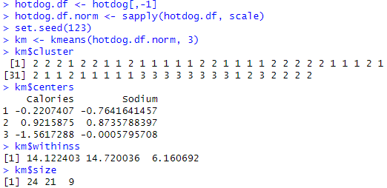
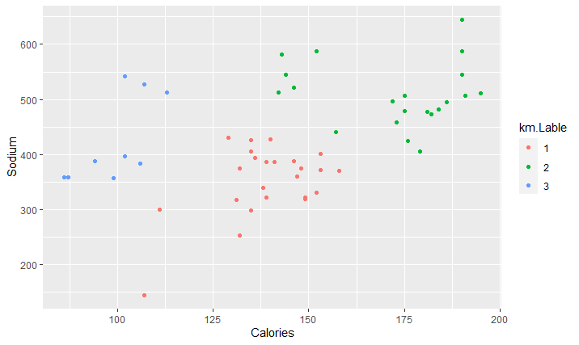
Example: Hotdogs
Clustering unlabeled hotdogs
within-cluster sum of squares
Clusters
3: low calories and medium sodium content
1: both calorie and sodium at medium levels
2: both calories and sodium at high levels
Notes:
hotdog.df <- hotdog[,-1]
hotdog.df.norm <- sapply(hotdog.df, scale)
set.seed(123)
km <- kmeans(hotdog.df.norm, 3)
km$cluster
km$centers
km$withinss
km$size
library(ggplot2)
km.Lable <- as.factor(km$cluster)
ggplot(hotdog.df, aes(Calories, Sodium, color = km.Lable)) + geom_point()
mydata <- hotdog.df.norm
wss <- (nrow(mydata)-1)*mean(apply(mydata,2,var))
for (i in 1:6) wss[i] <- mean(kmeans(mydata, centers=i)$withinss)
plot(1:6, wss, type="b", xlab="Number of Clusters (k)",
ylab="Average Within−Cluster Squared Distance")

Slide 15
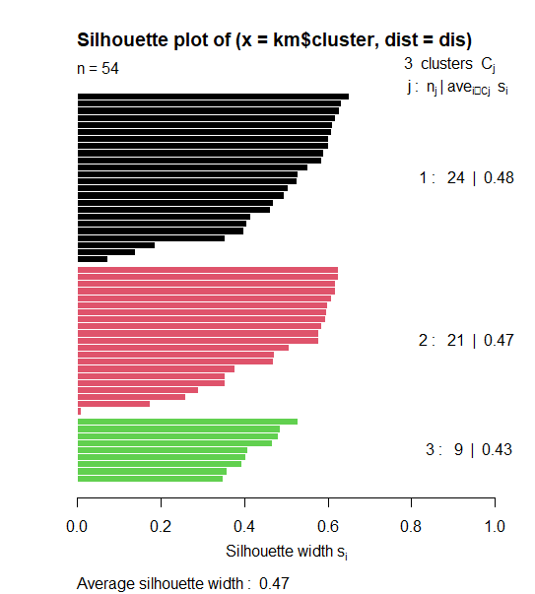
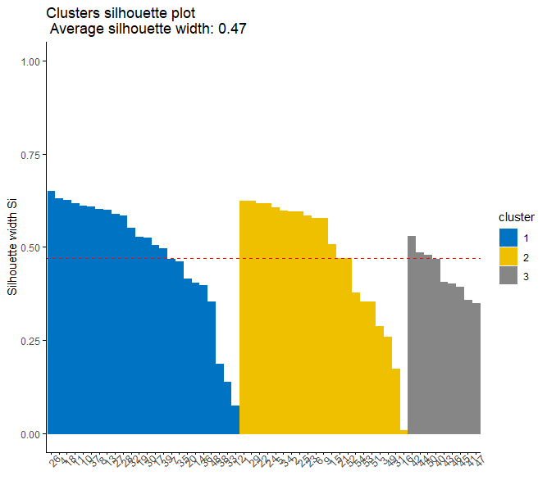
Example: Hotdogs
Clustering unlabeled hotdogs
Silhouette Plots
Notes:
library(cluster)
dis = dist(hotdog.df.norm)
sil = silhouette(km$cluster, dis)
summary(sil)
plot(sil, col=c(1:length(km$size)))
plot(sil, col=c(1:length(km$size)), border = NA)
factoextra::fviz_silhouette(sil, label=T, palette = "jco", ggtheme = theme_classic())

Slide 16
Case Study 1: Divorce and Consequences on Young Adults
Step 1 - collecting data
Step 2 - exploring and preparing the data
Step 3 - training a model on the data
Step 4 - evaluating model performance
Step 5 - usage of cluster information
Step 6 - model improvement
Tuning the parameter k

Slide 17
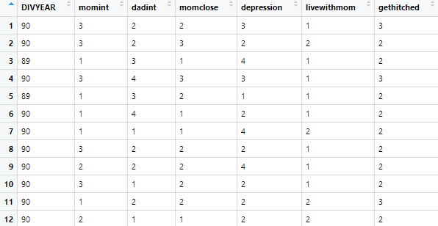
Collecting Data
Examining the consequences of recent parental divorce for young adults
Datafile: CaseStudy01_Divorce_YoungAdults_Data.csv
Notes:
Variables
DIVYEAR: Year in which parents were divorced. Dichotomous variable with 1989 and 1990
Child affective relations:
Momint: Mother intimacy. Interval level data with 4 possible responses (1-extremely close, 2-quite close, 3-fairly close, 4- not close at all)
Dadint: Father intimacy. Interval level data with 4 possible responses (1-extremely close, 2-quite close, 3-fairly close, 4-not close at all)
Live with mom: Polytomous variable with 3 categories (1- mother only, 2- father only, 3- both parents)
momclose: measure of how close the child is to the mother (1-extremely close, 2-quite close, 3-fairly close, 4- not close at all).
Depression: Interval level data regarding feelings of depression in the past 4 weeks. Possible responses are 1-often, 2-sometimes, 3-hardly ever, 4-never
Gethitched: Polytomous variable with 4 possible categories indicating respondent’s plan for marriage (1-Marry fairly soon, 2-marry sometime, 3-never marry, 8-don’t know)

Slide 18
Collecting Data
Examining the consequences of recent parental divorce for young adults
Driving challenges:
Are there differences in parent-child affective relations based on number of years post-divorce?
Do feelings of closeness to mom have a relationship with current depression symptoms?
Does living with mother have a relationship with considering getting married at some point?

Slide 19
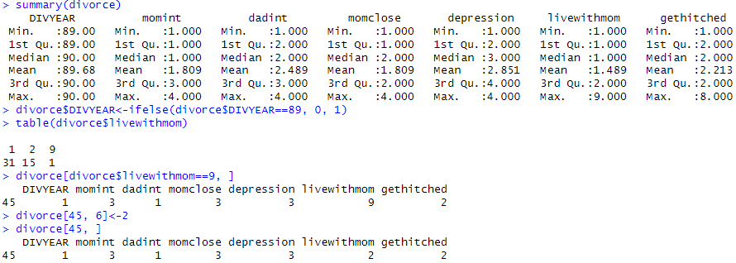
Exploring and Preparing the Data
Summary of all variables
Creating dummy and imputation
Converting to binary dummy variable
Respondents that feel much closer to their dads may be assigned livewithmom=2.

Slide 20
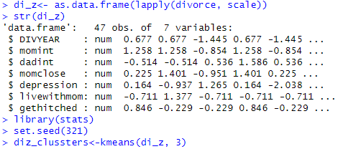
Training a Model on the Data
Using function kmeans() with k=3
Need to standardize the features

Slide 21
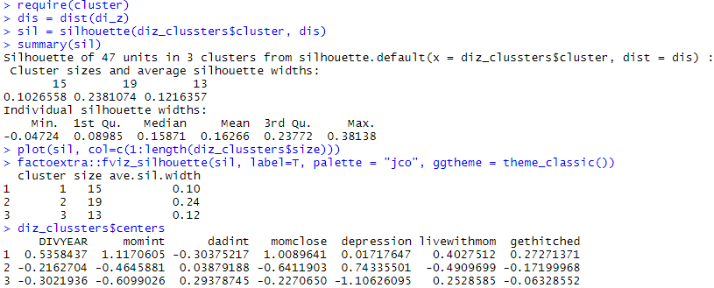
Evaluating Model Performance
The average Silhouette is reasonable

Slide 22
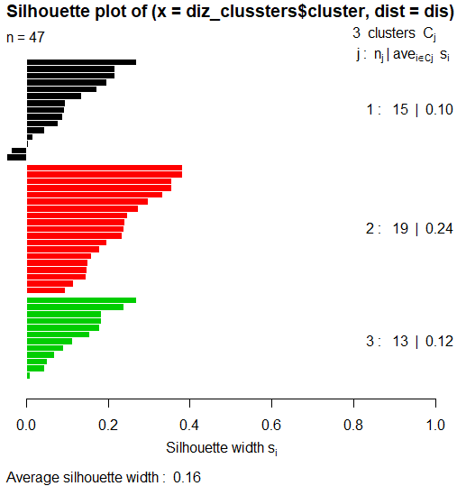
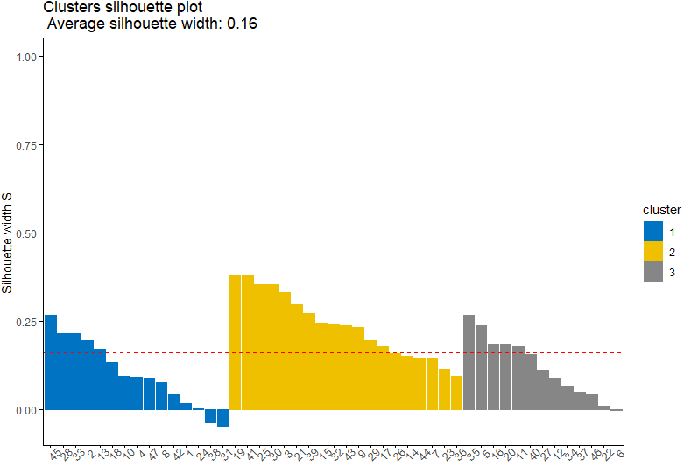
Evaluating Model Performance
The average Silhouette is reasonable 0.16

Slide 23
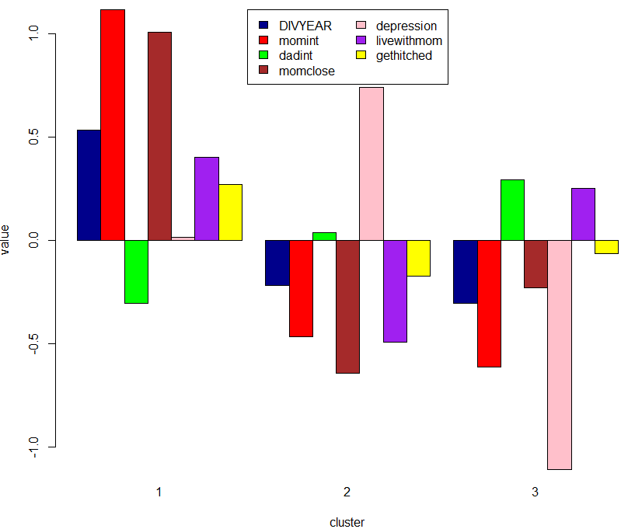
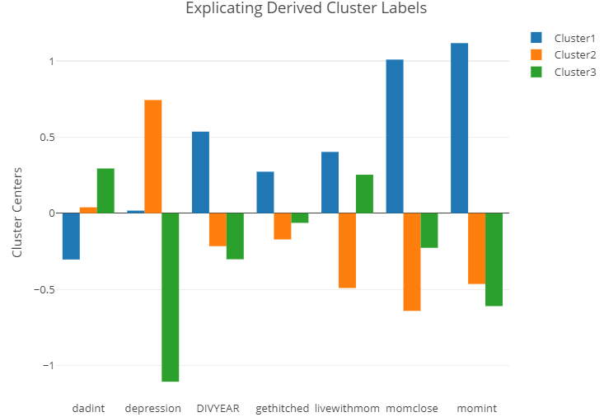
Evaluating Model Performance
Bar plots to visualize the difference between clusters

Slide 24
Usage of Cluster Information
The goal is to generate meaningful clusters
Cluster interpretability
Explore the characteristics of each cluster
Obtaining summary statistics from each cluster on each measurement
Average, min, and max
Examining the clusters for separation
Centroids, withinss, and size
Labeling the clusters based on the interpretation

Slide 25
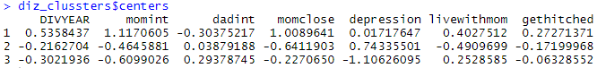
Usage of Cluster Information
The three clusters do contain three alternative types of young adults
Cluster 1 (emotional): divyear=mostly 90, momint=very close, dadint=not close, livewithmom=mostly mother, depression=not often, (gethiched) marry=will likely not get married.
Cluster 2 (naive): divyear=mostly 89, momint=not close, dadint=very close, livewithmom=father, depression=mild, marry=do not know/not inclined.
Cluster 3 (independent): divyear=mix of 89 and 90, momint=not close, dadint=not at all, livewithmom=mother, depression=sometimes, marry=tend to get married.

Slide 26
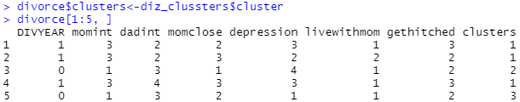
Usage of Cluster Information
Examine the relationship between live with mom and feel close to mom
Cluster 1 (emotional): close to their mom whether they live with their mom or not
Cluster 2 (naïve): closer to mom if they live with mom. However, they tend to be estranged from their mother
Cluster 3 (independent): closer to mom if they don’t live with her

Slide 27
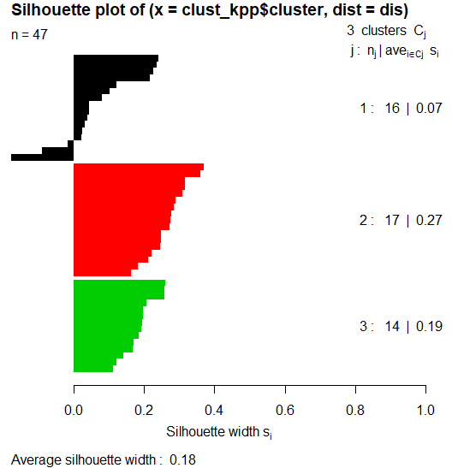
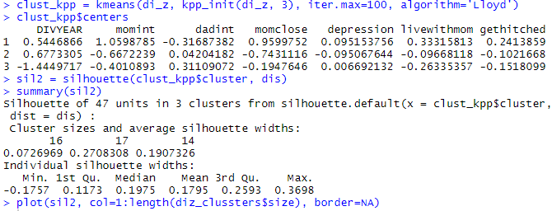
Model Improvement
Appropriate initialization of the k-means algorithm is of paramount importance
Use kpp_init method for optimal initialization
Some differences, but improvement is not substantial
Notes:
The k-means++ extension provides a practical strategy to obtain an optimal initialization for k-means clustering using a predefined kpp_init method.
we pick up centroids that are far away from one another. This increases the chances of initially picking up centroids that lie in different clusters.
https://www.geeksforgeeks.org/ml-k-means-algorithm/

Slide 28
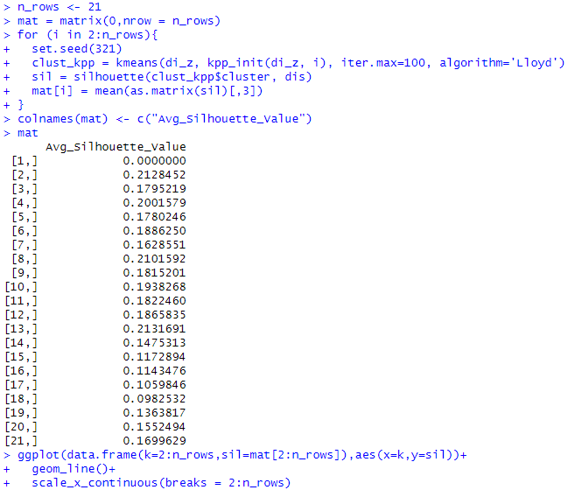
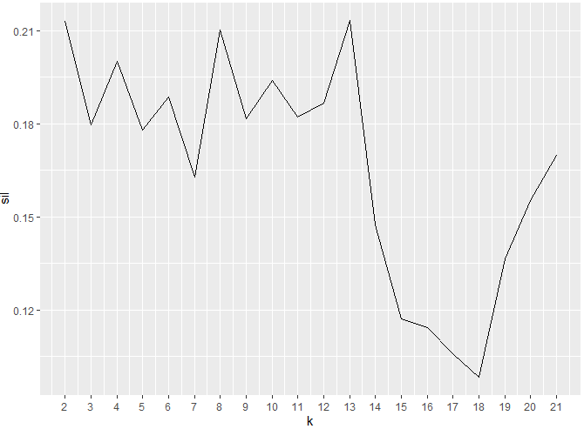
Tuning the Parameter k
Tune the k-means parameters, including centers initialization and k
Notes:
#This suggests that k∼3 or 4 may be an appropriate number of clusters to use in this case.
#Number of clusters (k) should not be too big or too small
mydata <- di_z
wss <- (nrow(mydata)-1)*mean(apply(mydata,2,var))
for (i in 1:10) wss[i] <- mean(kmeans(mydata, centers=i)$withinss)
plot(1:10, wss, type="b", xlab="Number of Clusters (k)",
ylab="Average Within−Cluster Squared Distance")

Slide 29
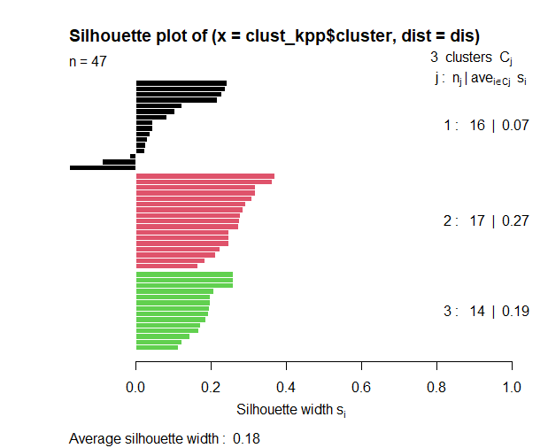
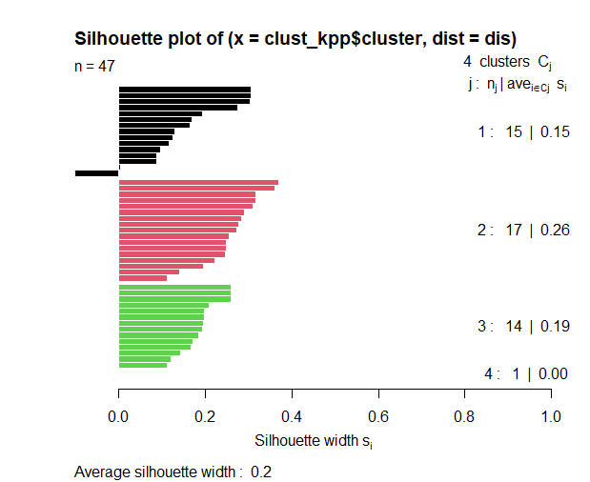
Tuning the Parameter k
Tune the k-means parameters, including centers initialization and k
Clustering with k = 3 & 4
Notes:
# observation 42?
factoextra::fviz_silhouette(sil3, label=T, palette = "jco", ggtheme = theme_classic())

Slide 30
Hierarchical Clustering
Hierarchical clustering represents a family of techniques that build hierarchies of clusters using one of two complementary strategies:
Generative methods (also known as agglomerative)
Discriminative methods (also known as divisive)
Distance measures (or linkages)
single, average, complete, and ward
Dendrogram
Presenting hierarchical clustering result
Notes:
P.437, Shmueli, Machine Learning for Business Analytics: Concepts, Techniques, and Applications in R
Single linkage (using minimum distance)
Complete linkage (using maximum distance)
Average linkage (using average distance)
UPGMA (Unweighted pair-group method using averages)
Centroid linkage (using centroid distance)
UPGMC (Unweighted pair-group method using centroids)
Ward’s method
Considers the “loss of information”
Measure “error sum of squares” (ESS) that measures the difference between individual records and a group mean

Slide 31
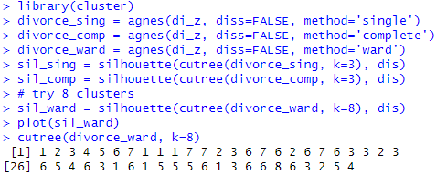
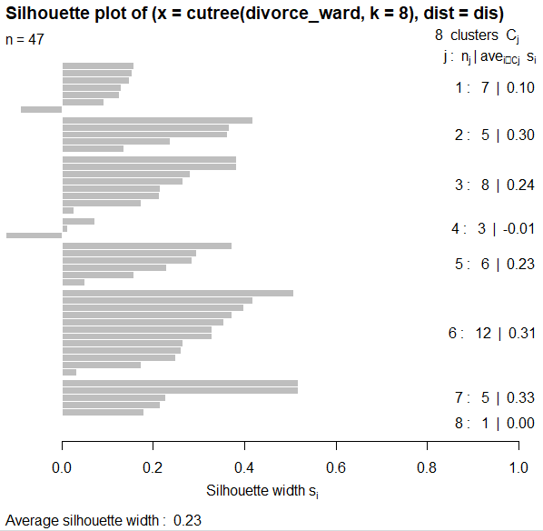
Hierarchical Clustering
Hierarchical clustering -- agglomerative nesting
Use agnes() function in the cluster package
Notes:
There are a number of R hierarchical clustering packages, including:
hclust in base R
agnes in the cluster package

Slide 32
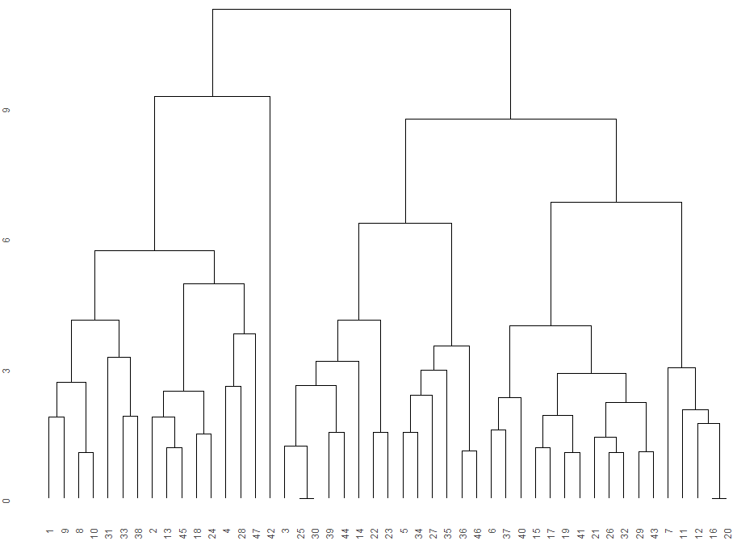
Hierarchical Clustering
The clusters in ward linkage
cutoff line
(creates 8 clusters)
Notes:
# observation 42?

Slide 33
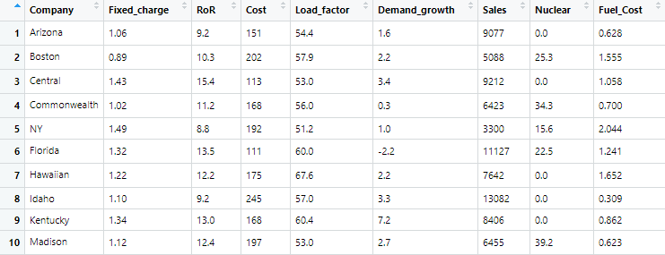
Example: Public Utilities
22 public utilities in the United States
Forming groups of similar utilities
Notes:
P.427, Shmueli, Machine Learning for Business Analytics: Concepts, Techniques, and Applications in R
Variables:
Fixed = fixed-charge covering ratio (income/debt)
RoR = rate of return on capital
Cost = cost per kilowatt capacity in place
Load = annual load factor
Demand = peak kilowatthour demand growth from 1974 to 1975
Sales = sales (kilowatthour use per year)
Nuclear = percent nuclear
Fuel Cost = total fuel costs (cents per kilowatthour)

Slide 34
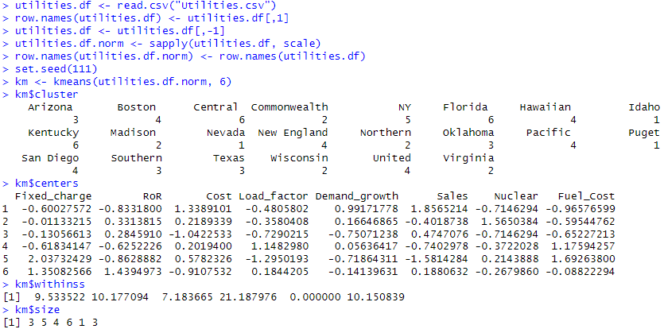
Example: Public Utilities
k-means clustering of 22 utilities into k = 6 clusters
Notes:
utilities.df <- read.csv("Utilities.csv")
row.names(utilities.df) <- utilities.df[,1]
utilities.df <- utilities.df[,-1]
utilities.df.norm <- sapply(utilities.df, scale)
row.names(utilities.df.norm) <- row.names(utilities.df)
set.seed(111)
km <- kmeans(utilities.df.norm, 6)
km$cluster
km$centers
km$withinss
km$size

Slide 35
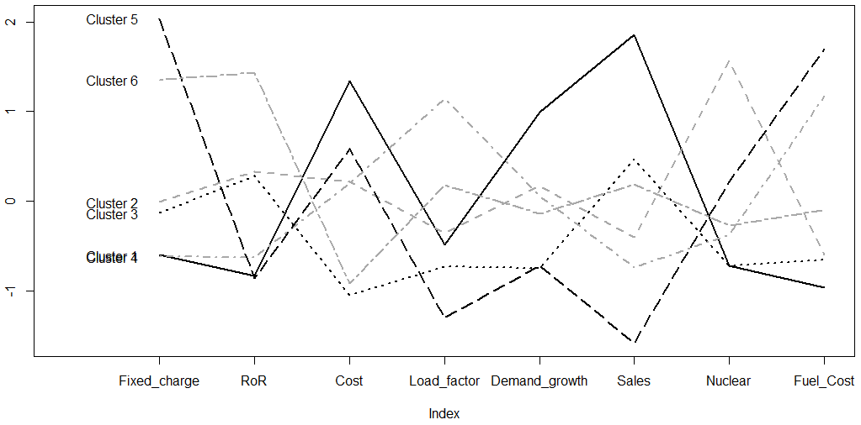
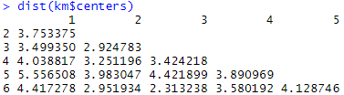
Example: Public Utilities
Visual presentation (profile line plot) of cluster centroids
Notes:
library(ggplot2)
km.Lable <- as.factor(km$cluster)
ggplot(utilities.df, aes(Sales, Fuel_Cost, color = km.Lable)) + geom_point()
plot(c(0), xaxt = 'n', ylab = "", type = "l",
ylim = c(min(km$centers), max(km$centers)), xlim = c(0, 8))
axis(1, at = c(1:8), labels = names(utilities.df))
for (i in c(1:6))
lines(km$centers[i,], lty = i, lwd = 2, col = ifelse(i %in% c(1, 3, 5),
"black", "dark grey"))
text(x = 0.5, y = km$centers[, 1], labels = paste("Cluster", c(1:6)))
dist(km$centers)

Slide 36
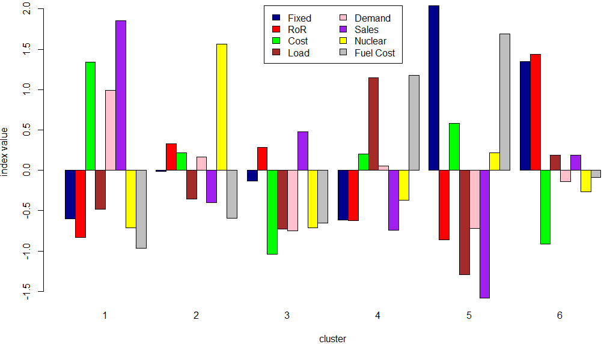
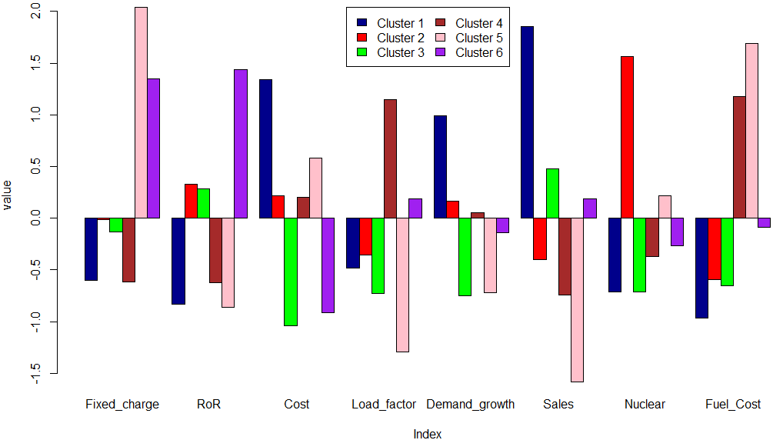
Example: Public Utilities
Visual presentation (profile bar plot) of cluster centroids
Notes:
myColors <- c("darkblue", "red", "green", "brown", "pink", "purple")
barplot(km$centers, beside = TRUE, xlab="Index", ylab="value", col = myColors)
legend("top", ncol=2, legend = c("Cluster 1", "Cluster 2", "Cluster 3", "Cluster 4", "Cluster 5", "Cluster 6"), fill = myColors)
myColors <- c("darkblue", "red", "green", "brown", "pink", "purple", "yellow", "grey")
barplot(t(km$centers), beside = TRUE, xlab="cluster", ylab="index value", col = myColors)
legend("top", ncol=2, legend = c("Fixed", "RoR", "Cost", "Load", "Demand", "Sales", "Nuclear", "Fuel Cost "), fill = myColors)

Slide 37
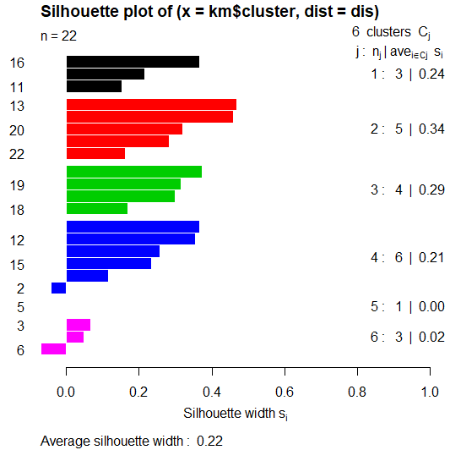
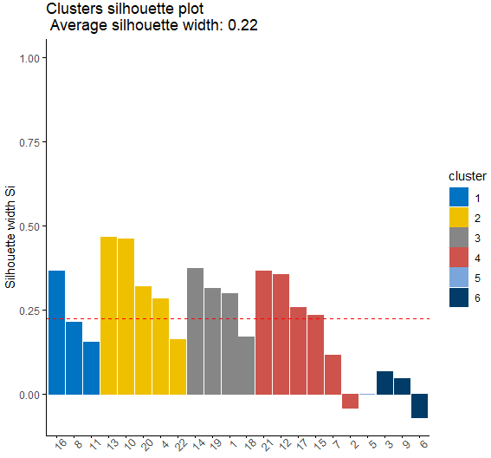
Example: Public Utilities
Silhouette plot – validation of clustering consistency
Notes:
library(cluster)
dis = dist(utilities.df.norm)
sil = silhouette(km$cluster, dis)
summary(sil)
plot(sil, col=c(1:length(km$size)))
plot(sil, col=c(1:length(km$size)), border = NA)
factoextra::fviz_silhouette(sil, label=T, palette = "jco", ggtheme = theme_classic())

Slide 38
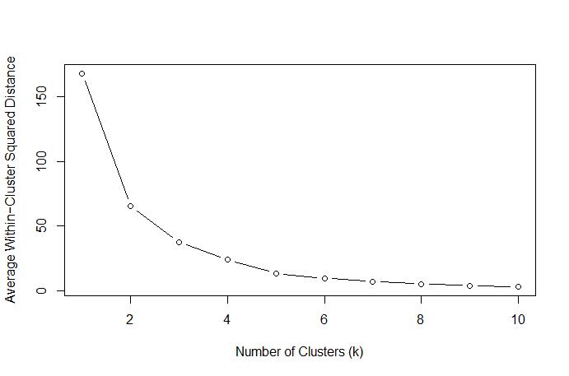
Example: Public Utilities
Comparing different choice of k in terms of overall average within-cluster distance
The “elbow chart” – a line chart depicting the decline in cluster heterogeneity
Notes:
mydata <- utilities.df.norm
wss <- (nrow(mydata)-1)*mean(apply(mydata,2,var))
for (i in 1:6) wss[i] <- mean(kmeans(mydata, centers=i)$withinss)
plot(1:6, wss, type="b", xlab="Number of Clusters (k)",
ylab="Average Within−Cluster Squared Distance")

Slide 39
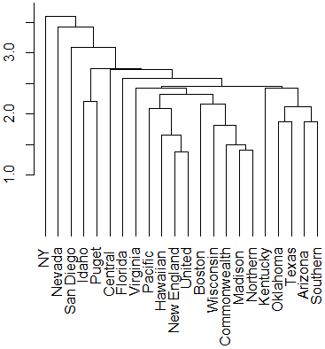

Hierarchical Clustering on Public Utilities
Single linkage for all 22 utilities, using all 8 normalized measurements
Use hclust() function in the stats package
cutoff line
(creates 6 clusters)
Computing cluster membership by “cutting” the dendrogram:
cut at height 2.7
use cutree(hc1, h = 2.7) to cut the tree by height
Notes:
d.norm <- dist(utilities.df.norm, method = "euclidean")
# in hclust() set argument method = to "ward.D", "single", "complete", "average", "median", or "centroid"
hc1 <- hclust(d.norm, method = "single")
plot(hc1, hang = -1, ann = FALSE)
hc2 <- hclust(d.norm, method = "average")
plot(hc2, hang = -1, ann = FALSE)
# cutting by number of clusters
memb <- cutree(hc1, k = 6)
memb
memb <- cutree(hc2, k = 6)
memb
# cutting by height where the tree should be cut
memb <- cutree(hc1, h = 2.7)
memb
memb <- cutree(hc2, h = 3.5)
memb

Slide 40


Hierarchical Clustering on Public Utilities
Average linkage for all 22 utilities, using all 8 normalized measurements
Use hclust() function in the stats package
cutoff line
(creates 6 clusters)
Computing cluster membership by “cutting” the dendrogram:
cut at height 3.5
use cutree(hc2, h = 3.5) to cut the tree by height
Notes:
# use agnes() function
hc1_agnes <-agnes(d.norm, method='single')
ggdendrogram(as.dendrogram(hc1_agnes), leaf_labels=TRUE, labels=TRUE)

Slide 41


Hierarchical Clustering on Public Utilities
Cut a tree into groups of data with function cutree()
Specify k for cutting by number of clusters
Specify h for cutting by height

Slide 42



Hierarchical Clustering on Public Utilities
Draw rectangles around hierarchical clusters with function rect.hclust()
Specify k for cutting by number of clusters
Specify h for cutting by height
Average linkage dendrogram clusters
Cluster: 5
3
6
4
2
1
Notes:
# cutting by number of clusters
plot(hc1, hang = -1, ann = FALSE)
rect.hclust(hc1, k = 6)
plot(hc2, hang = -1, ann = FALSE)
rect.hclust(hc2, k = 6)
# cutting by height where the tree should be cut
plot(hc1, hang = -1, ann = FALSE)
rect.hclust(hc1, h = 2.7)
plot(hc2, hang = -1, ann = FALSE)
rect.hclust(hc2, h = 3.5)

Slide 43
Summary
Clustering may be most appropriate for exploratory data analytics
Clustering approaches are for unsupervised learning
Flexible and efficient
Clusters may be used for classification
Need inputs and decisions by the analyst
Need to decide the linkage method

